Slide 1
PCMA Strategic Communications
State Health Advisory Committee
October 2019

Slide 2
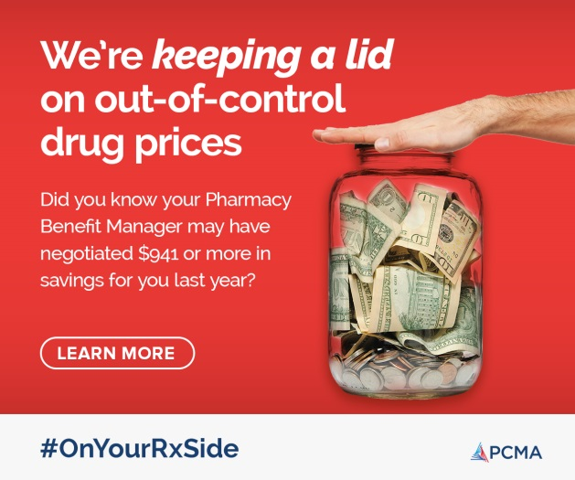
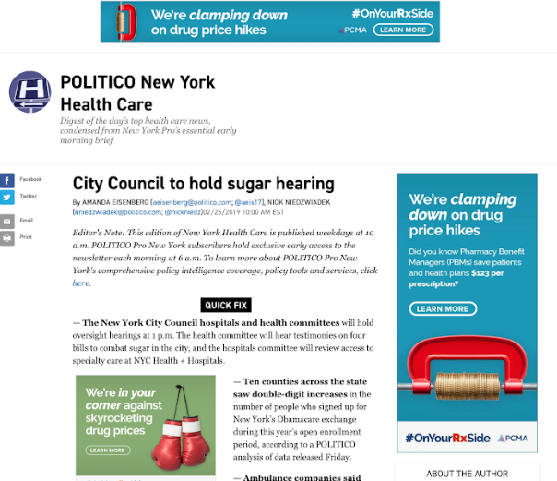
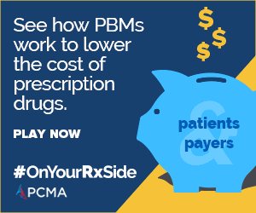
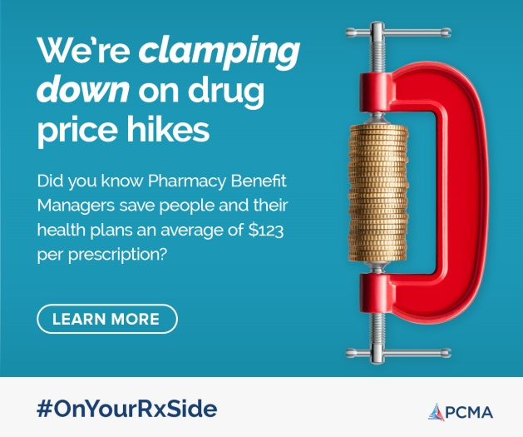
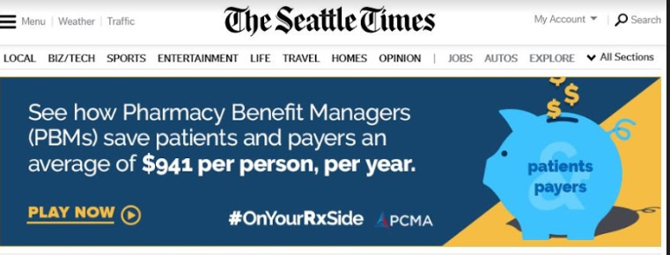
Our Approach
Digital ads with patient-centric language--emphasizing “out-of-control” drug prices, targeting influencers and policymakers in Washington, D.C./target states with the goal of reducing the awareness gap about PBMs.
Creative directing viewers to an animated video that describes what PBMs do and how PBMs provide value to patients and payers.

Slide 3
#OnYourRxSide — State Activations
WASHINGTON
MONTANA
NORTH
MINNESOTA
MAINE
DAKOTA
VT
OREGON
NH
IDAHO
SOUTH
WISCONSIN
MASS
WYOMING
DAKOTA
MICHIGAN
NEW YORK
RI
IOWA
CONN
NEBRASKA
PENN
NEW
NEVADA
OHIO
JERSEY
UTAH
ILLINOIS
INDIANA
DELAWARE
COLORADO
WV
MARYLAND
CALIFORNIA
KANSAS
MISSOURI
VIRGINIA
KENTUCKY
NORTH
TENNESSEE
CAROLINA
ARIZONA
OKLAHOMA
ARKANSAS
SOUTH
NEW MEXICO
CAROLINA
MISS
ALABAMA
GEORGIA
TEXAS
FLORIDA
LOUISIANA
ALASKA
HAWAII

Slide 4
Our Approach – Next Phase
Continue emphasizing high-polling cost-control messaging on the value PBMs provide patients & payers.
Build in new themes emphasizing care-coordination, patient health and PBMs’ role in promoting better health outcomes.
Update campaign microsite to include content focused on care-coordination, patient health and outcomes.
Deploy state-focused advertisements emphasizing cost-control messaging with the goal of preventing, weakening or defeating harmful legislation.

Slide 5
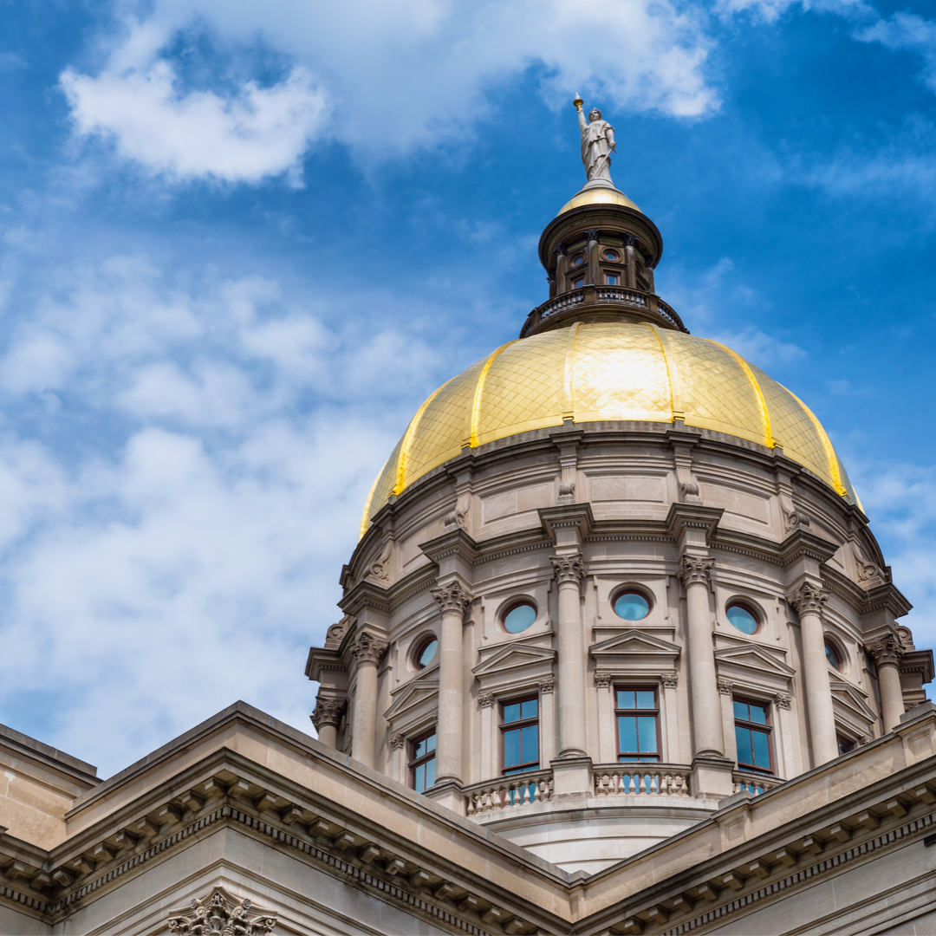
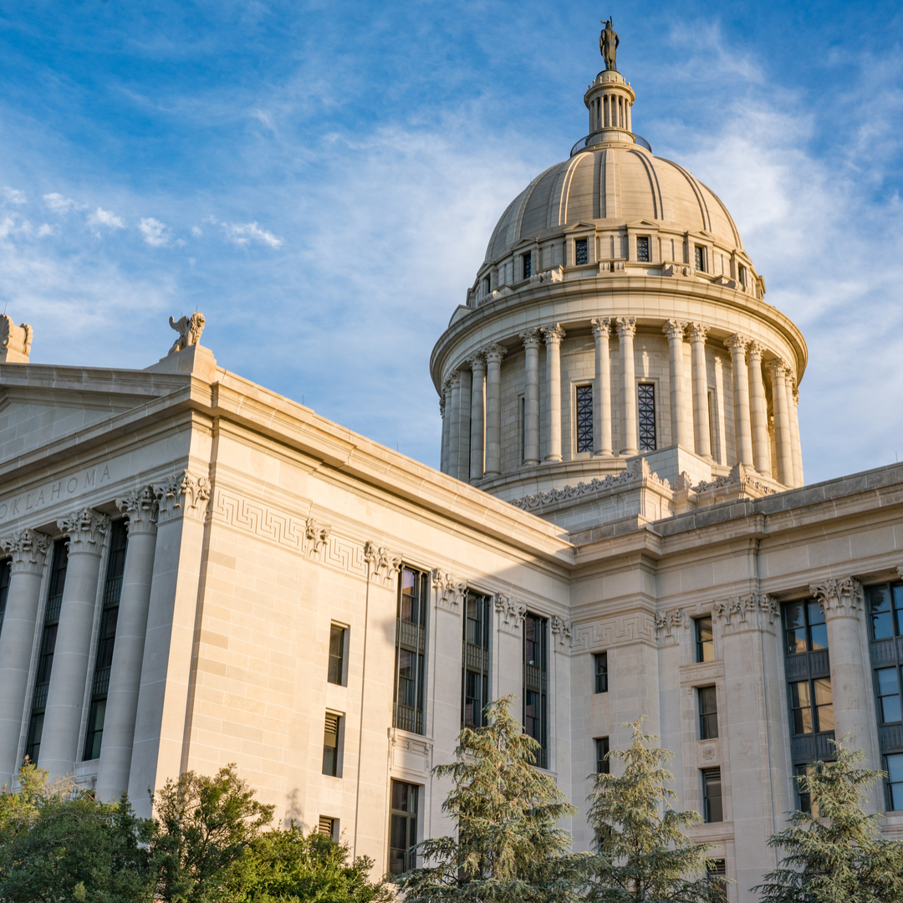
Georgia
Opposition to HB 233
Generated 23 constituent phone calls to each Georgia House member plus Lt. Governor for a total of 1,311 phone calls.
The governor received 500 phone calls urging a veto.
Oklahoma
Opposition to HB 2632
Each of the following state senators received 100 phone calls from constituents in opposition to HB 2632: Sens. Matthews, Brooks, McCortney, Quinn, Stanislawski, and Haste.

Slide 6
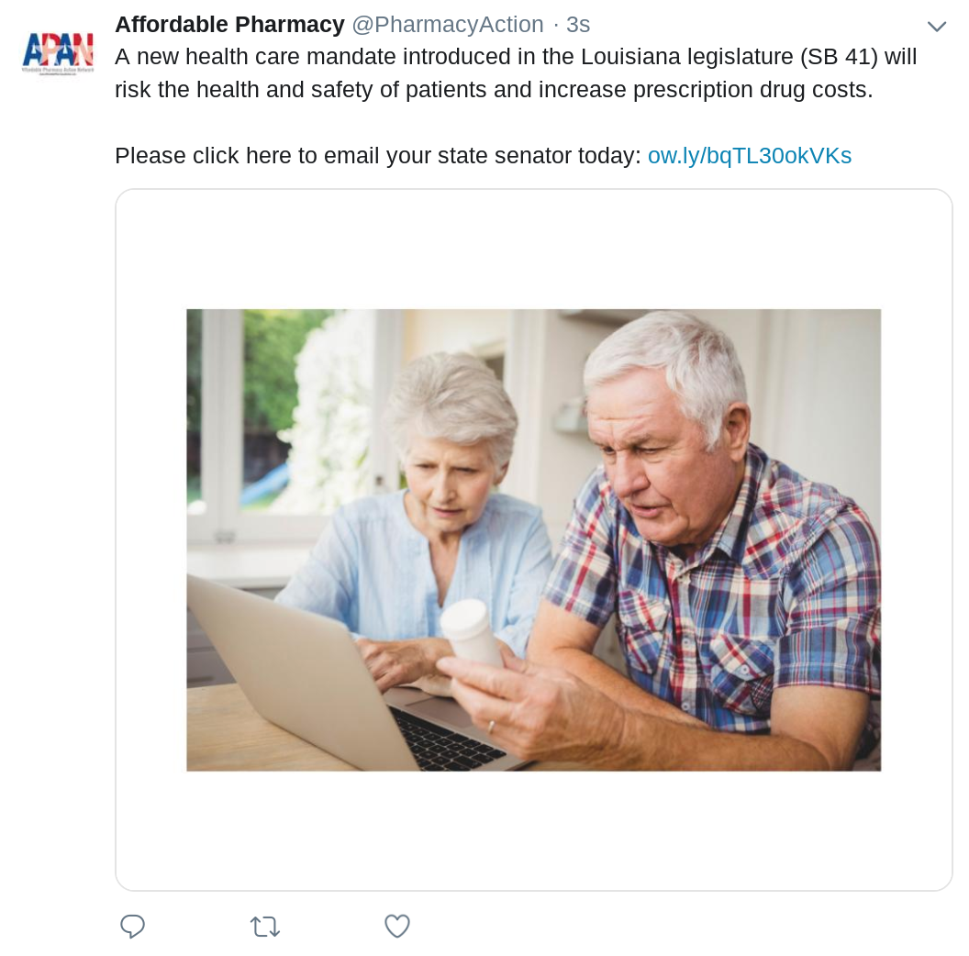
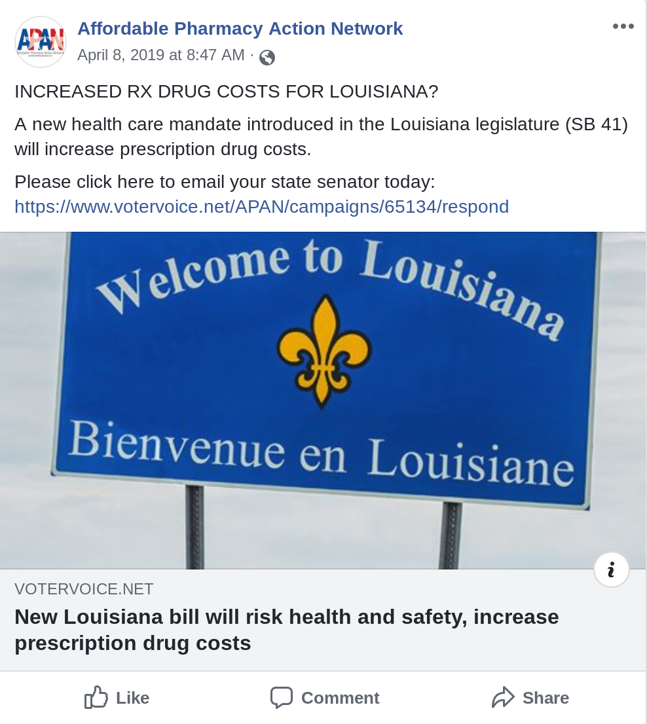
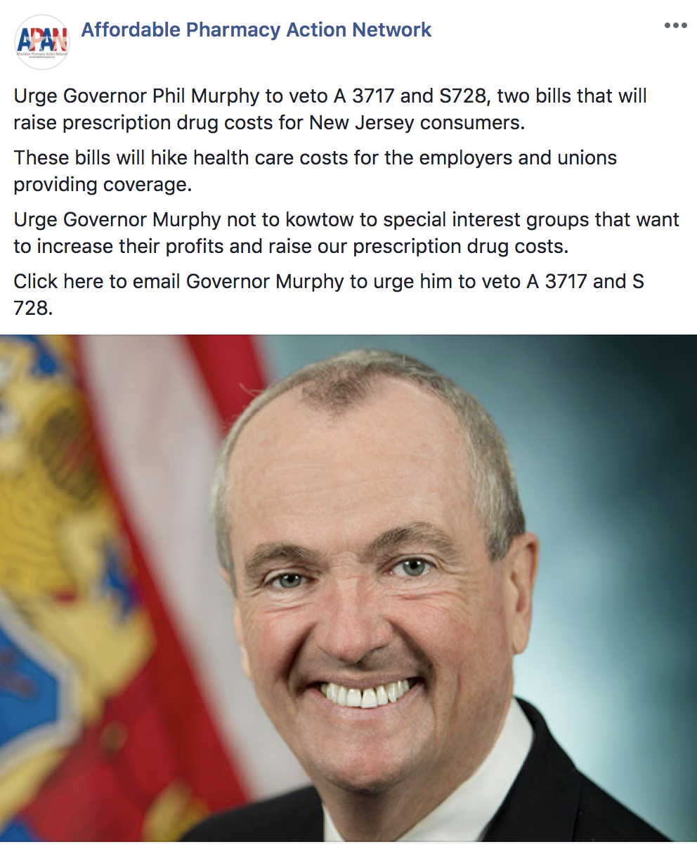
Louisiana
Opposition to SB 41
1,170 constituent phone calls to Louisiana State Senate members.
1,105 phone calls to members of the House Health & Welfare Committee
313 emails sent state senators.
498,041 impressions of Facebook ads with 3,522 clicks; 7,293 impressions of our promoted Tweets.
New Jersey
Opposition to A3717 and S728
1,000 phone calls to the governor urging a veto.
597 constituent emails sent to the governor.
264,599 impressions of our Facebook ads generated 5,728 clicks to our Web site.

Slide 7
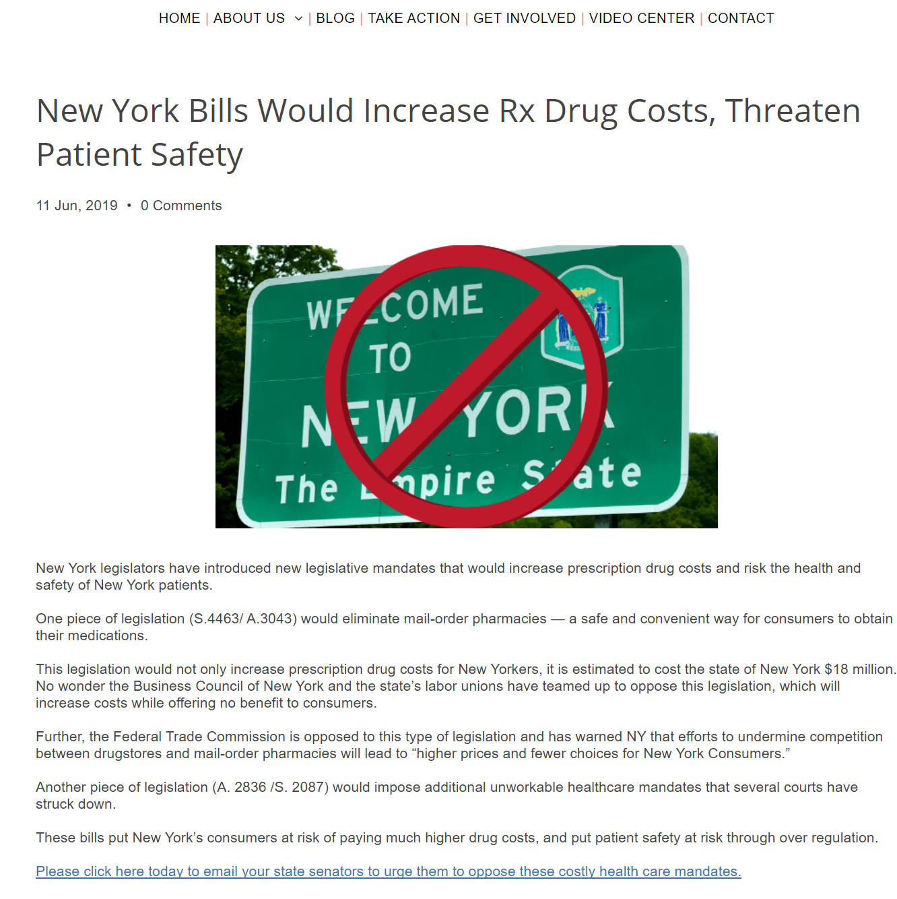
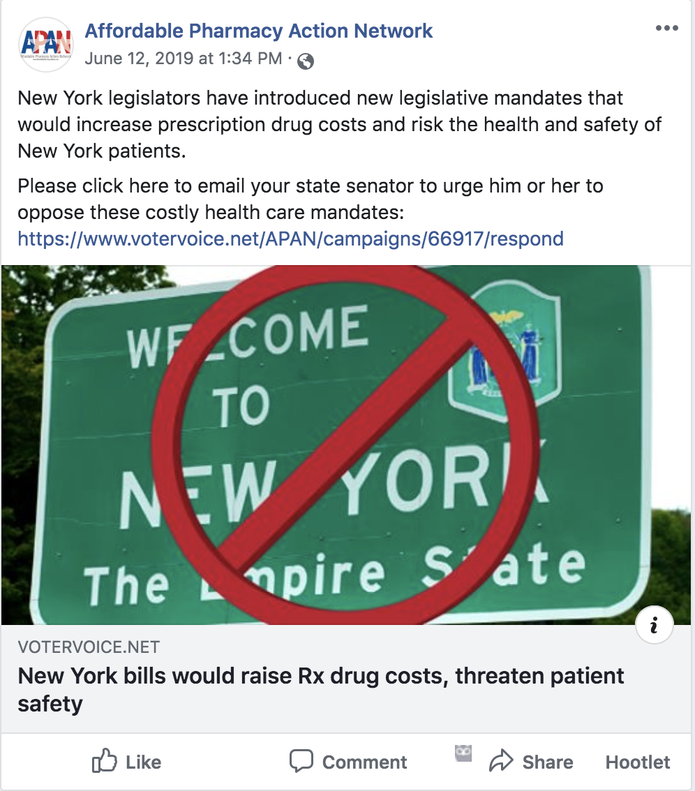
New York
Opposition to (S.4463/ A.3043)
Each of the following state senators received 100 phone calls from constituents in opposition to HB 2632: Sens. Bresline, Benjamin, Gianaris, Kennedy, Krueger, Mayer, Rivera, and Skoufis.
92 emails were sent to 39 different state senators in opposition to these bills.
Our Facebook promoted posts were seen 150,547 times within the targeted districts and generated 1,1514 clicks to our landing page and was shared 198 times.

Slide 8
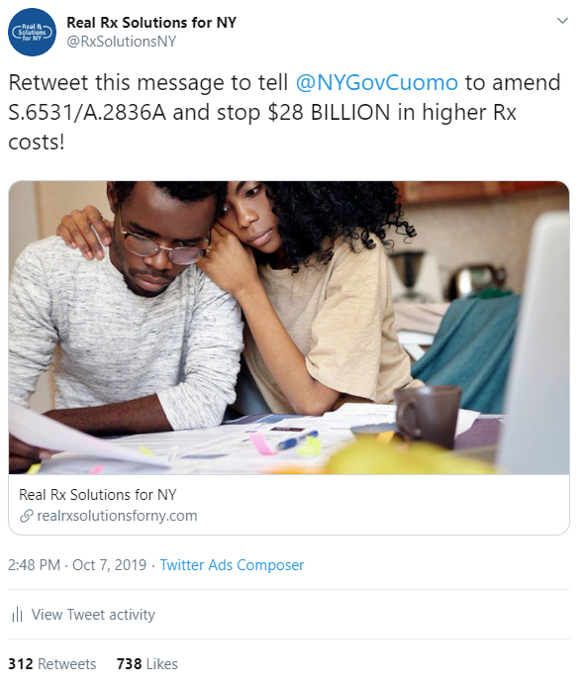
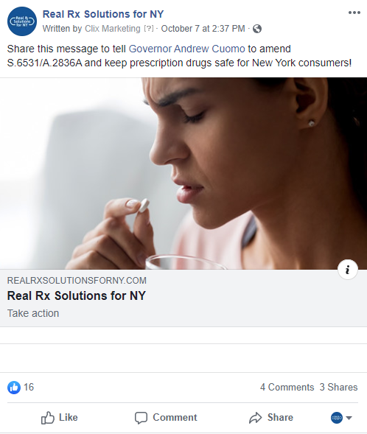
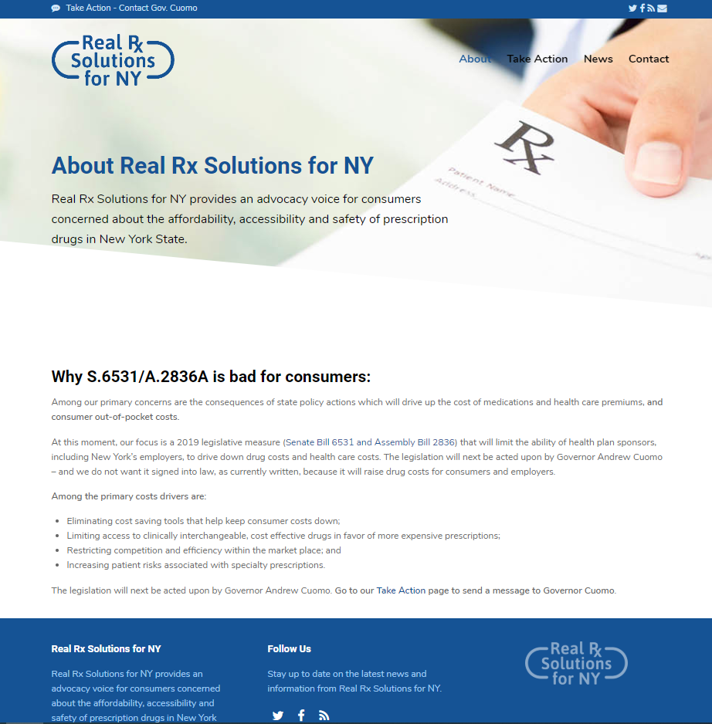
Real Rx Solutions for NY Campaign
Sample Twitter Ad
Sample Facebook Ad
Real Rx Solutions for NY Microsite
Since its launch in August 2019, the Real Rx Solutions for NY Campaign has generated
1.3 million impressions across Facebook, Twitter, Google and Spotify.
The campaign has successfully used microtargeting capabilities (geographic location,
user interests, etc.) to ensure message delivery to key audiences.

Slide 9
46brooklyn Research is Fatally Flawed
A Visante analysis of research produced by 46brooklyn, and their consulting arm 3 Axis Advisors, shows that the data and methodology used to produce their reports makes their conclusions wholly uncredible.
WHAT DID VISANTE FIND?
Visante’s analysis found that 46brooklyn’s research selectively chose specific drugs to fit their preferred findings by “cherry picking” drug pricing data. Analysis based on cherry-picked data isn’t a “limitation,” it’s a fatal flaw.
46brooklyn uses public data inappropriately. The National Average Drug Acquisition Cost (NADAC) data do not represent the actual net PBM payments for the specified drugs at retail pharmacies.
46brooklyn has a bad case of tunnel vision
46brooklyn’s methodology is based on evaluating the costs of an entire pharmacy benefit based on only one sliver of drug spending.

Slide 10
Editorial Board & Health Care Reporter Outreach Program
Goal: Education media outlets and health reporters on the PBM value proposition.
Initial target list of states includes: Arkansas; California; Illinois; Florida; Georgia; Louisiana; Massachusetts; New York; Ohio; Oklahoma; Oregon; Pennsylvania.
Target Publications: media outlets in state capitals and major metropolitan areas.

