Slide 1
URAC Pharmacy Accreditation Programs

Slide 2
Presenter
Heather Bonome, PharmD
Director of Pharmacy

Slide 3
Agenda
URAC Overview
Accreditation Process
Value of Accreditation
Pharmacy Quality Management Programs
Questions

Slide 4
Founded in 1990 as an independent, third party validator of the quality in healthcare using best practices
Notes:
URAC offers 24 accreditation and certification programs
URAC accredited organizations touch patients in every state in the country.
URAC has thrived for almost 27 years by separating ourselves from others by who we are and how we do it

Slide 5
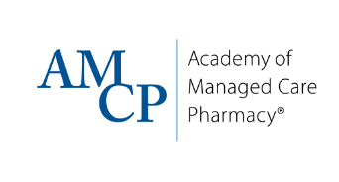
Diverse Stakeholders Govern URAC
Notes:
Here is a view of some of URAC’s volunteer Board member organizations. As you can see URAC’s Board comprises a broad range of organizations representing different areas of health care.
The URAC Board also maintains at-large representatives from consumer groups, public organizations, and other industry experts.
Q: What stands out on this slide?
A: The wide variety of organizations and professions represented.
While these groups come from all corners of healthcare, they have one thing in common – securing the best care for the patient.
This unifying factor is the foundation on which URAC builds our programs.
Note that the blank space represents the position held for a consumer representative on URAC’s Board. URAC is in the process of filling this vacancy.

Slide 6
Peer Committee Structure
Board of Directors
Advisory Committees
Health Standards Committee
Pharmacy Advisory Council
Measures & Research Advisory Group
Accreditation Committee

Slide 7
Notes:
URAC has broad expertise over many decades that informs all of our programs. This is indicative our diverse governance board and process whereby we seek diverse viewpoints when crafting out standards.

Slide 8
Accreditation Process

Slide 9
Accreditation Process
Submit Application
Desktop Review
Ongoing Compliance
Validation Review
Accreditation Committee Review
The accreditation process typically takes 4-6 months.
Notes:
New picture of the 5 phases with support/tools/resources and timing along the bottom
URAC provides a dedicated team and tools throughout each phase of accreditation.

Slide 10
Ongoing Compliance
Measures Reporting
Monitoring Validation Reviews
Notices of Change
For Cause Reviews

Slide 11
Value of Accreditation

Slide 12
Why URAC Accreditation?
Validates compliance with industry’s most rigorous standards
Provides a quality framework
Demonstrates value through measurement & reporting
Ensures continuous quality improvement
Leaders and teams use accreditation to improve performance and demonstrate value.
Notes:
Many leaders use this independent evaluation as a quality tool.
URAC accreditation validates the achievement of the industry’s most comprehensive and rigorous standards
Accreditation provides:
Standards framework to build a quality health service organization
Performance analysis to identify areas for improvement
Educational process to inform priorities and plans for improvement
Measurement, reporting, and monitoring to sustain accreditation readiness and continuous quality improvement
Additional points:
URAC accreditation is the most effective way for an organization to demonstrate its commitment to quality
URAC offers:
Rigorous, evidence-based standards and review processes that result in optimal benefit to the consumer of care
Thought leadership in key areas of healthcare from experienced URAC leaders and the input of industry experts who are close to health delivery systems and know its unique challenges
An independent validation of quality through accreditation programs that act as a key differentiator of performance
A systematic approach to quality management to mitigate the human and economic cost of poor quality

Slide 13
Pharmacy Quality Management® Programs

Slide 14
URAC’s Pharmacy Expertise
Premier accreditor of pharmacies and pharmacy benefit management organizations
Unique insight into intersection between payers and pharmacies and the impact on quality
Leading national pharmacy quality measurement efforts
Notes:
Highlight the unique role of URAC as an independent accreditor with no consulting services provided to organizations. Note our leadership in pharmacy is broad as we address many areas of pharmacy quality. Note that our expertise is rooted in our knowledge of the relationship between PBMs and their pharmacy networks and how this impacts quality.

Slide 15
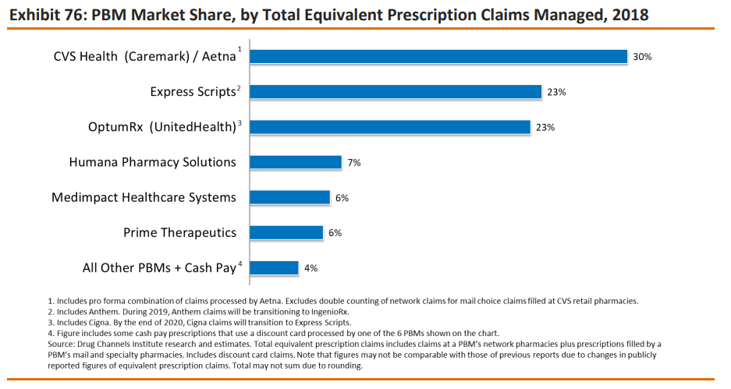
PBM Accreditation: Overview
Leading accreditor of PBMs
26 organizations hold URAC PBM Accreditation
URAC accredits more than 95% of PBM market including the six largest PBMs
Drug Channels 2019 Economic Report on U.S. Pharmacies and Pharmacy Benefit Managers, Exhibit 76 PBM Market Share, Total Equivalent Prescription Claims Managed, 2018

Slide 16
PBM Accreditation
Pharmacy & Therapeutics Committee
Formulary Development
Drug Utilization Management
Pharmacy Network Management
Customer Service & Communications
Quality Management

Slide 17
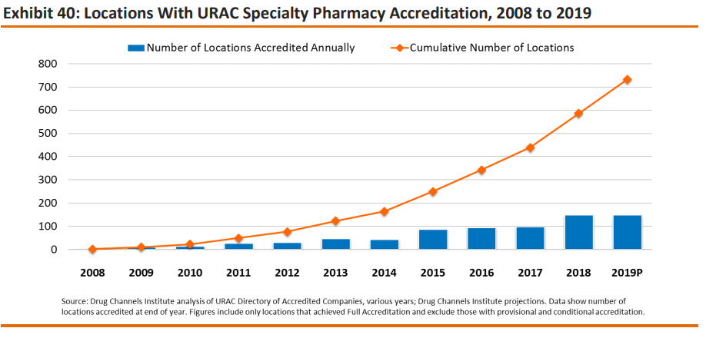
Specialty Pharmacy Accreditation: Overview
Over 450+ organizations achieved URAC Specialty Pharmacy Accreditation
Many different practice models of specialty pharmacies have achieved accreditation
URAC accredits the nation’s 15 largest specialty pharmacies*
* The 2019 Economic Report on U.S. Pharmacies and Pharmacy Benefit Managers, Exhibit 41: Prescription Revenues and Market Share from Specialty Pharmaceuticals, by Company, 2018

Slide 18
Mail Service Pharmacy Accreditation
65+ organizations have achieved URAC MSP Accreditation
URAC has accredited large, multi-site mail service pharmacies as well as many smaller mail service pharmacy practices

Slide 19
SPP & MSP v4.0 Focus Areas
Foundational
Risk Management
Consumer Protection and Empowerment
Operations and Infrastructure
Performance Monitoring and Improvement
Program
Pharmacy Dispensing
Pharmacy Product Handling and Security
Patient Service and Communication
Patient Management*
Reporting Performance Measures
* Applies to SPP only

Slide 20
Mail Service & Specialty Pharmacy Accreditation: Operations
Goal: The pharmacy has defined operations with the ability to measure quality and service performance.
Prescription Dispensing
Medication Handling, Storage, & Inventory
Temperature Management & Distribution
Handling/ Removal of Hazardous Materials
Facility Safety and Security
Quality and Error Management

Slide 21
Specialty Pharmacy Accreditation: Patient Management
Goal: A patient-centered strategy providing clinical services that meet the individual needs of the patient to optimize therapeutic outcomes.
Initial Clinical Assessment
Periodic Reassessment
Patient Education
Evidence-Based Research Practices
Coordination of Care
Demonstrate Value through Outcomes

Slide 22
The URAC Difference
More rigor to drive better organizations
Leading national efforts to promote quality measurement and reporting
The process matters

Slide 23
Contact Information
Heather Bonome, PharmD
Director of Pharmacy
Email: hbonome@urac.org
(202) 326-3958

Slide 24
Questions?
Notes:
100% discount for early adopters – which we have defined as organizations who sign up on/before 7/31/19.
Do Not Offer regular pricing at this point, but be prepared to share during Q&A.
$12K is list price
50% discount or $6K for applicants who pursue at the same time as SPP (either initial or reaccreditation)

