Slide 1

Manufacturer Coupons Increase Prescription Drug Spending by Billions
Coupons increase prescription drug costs by
$32 billion over a decade. Here’s how and
what can be done to help.

Slide 2
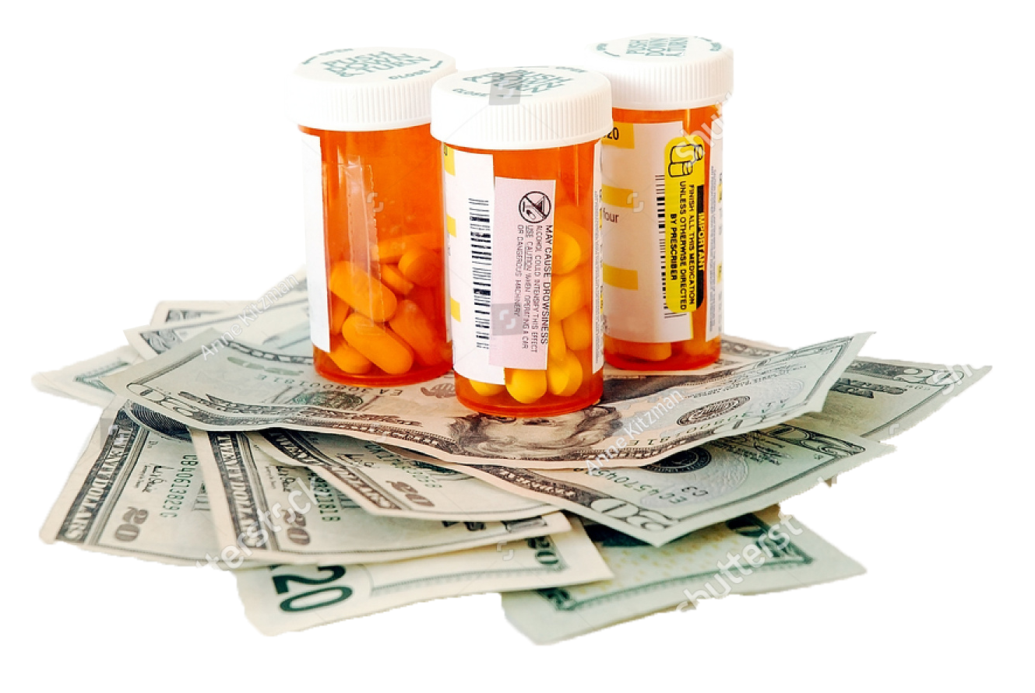
Coupons and other forms of patient assistance offered by drug manufacturers keep prices high and increase the costs patients pay, making it harder for patients to afford their prescription drugs and health insurance overall.

Slide 3
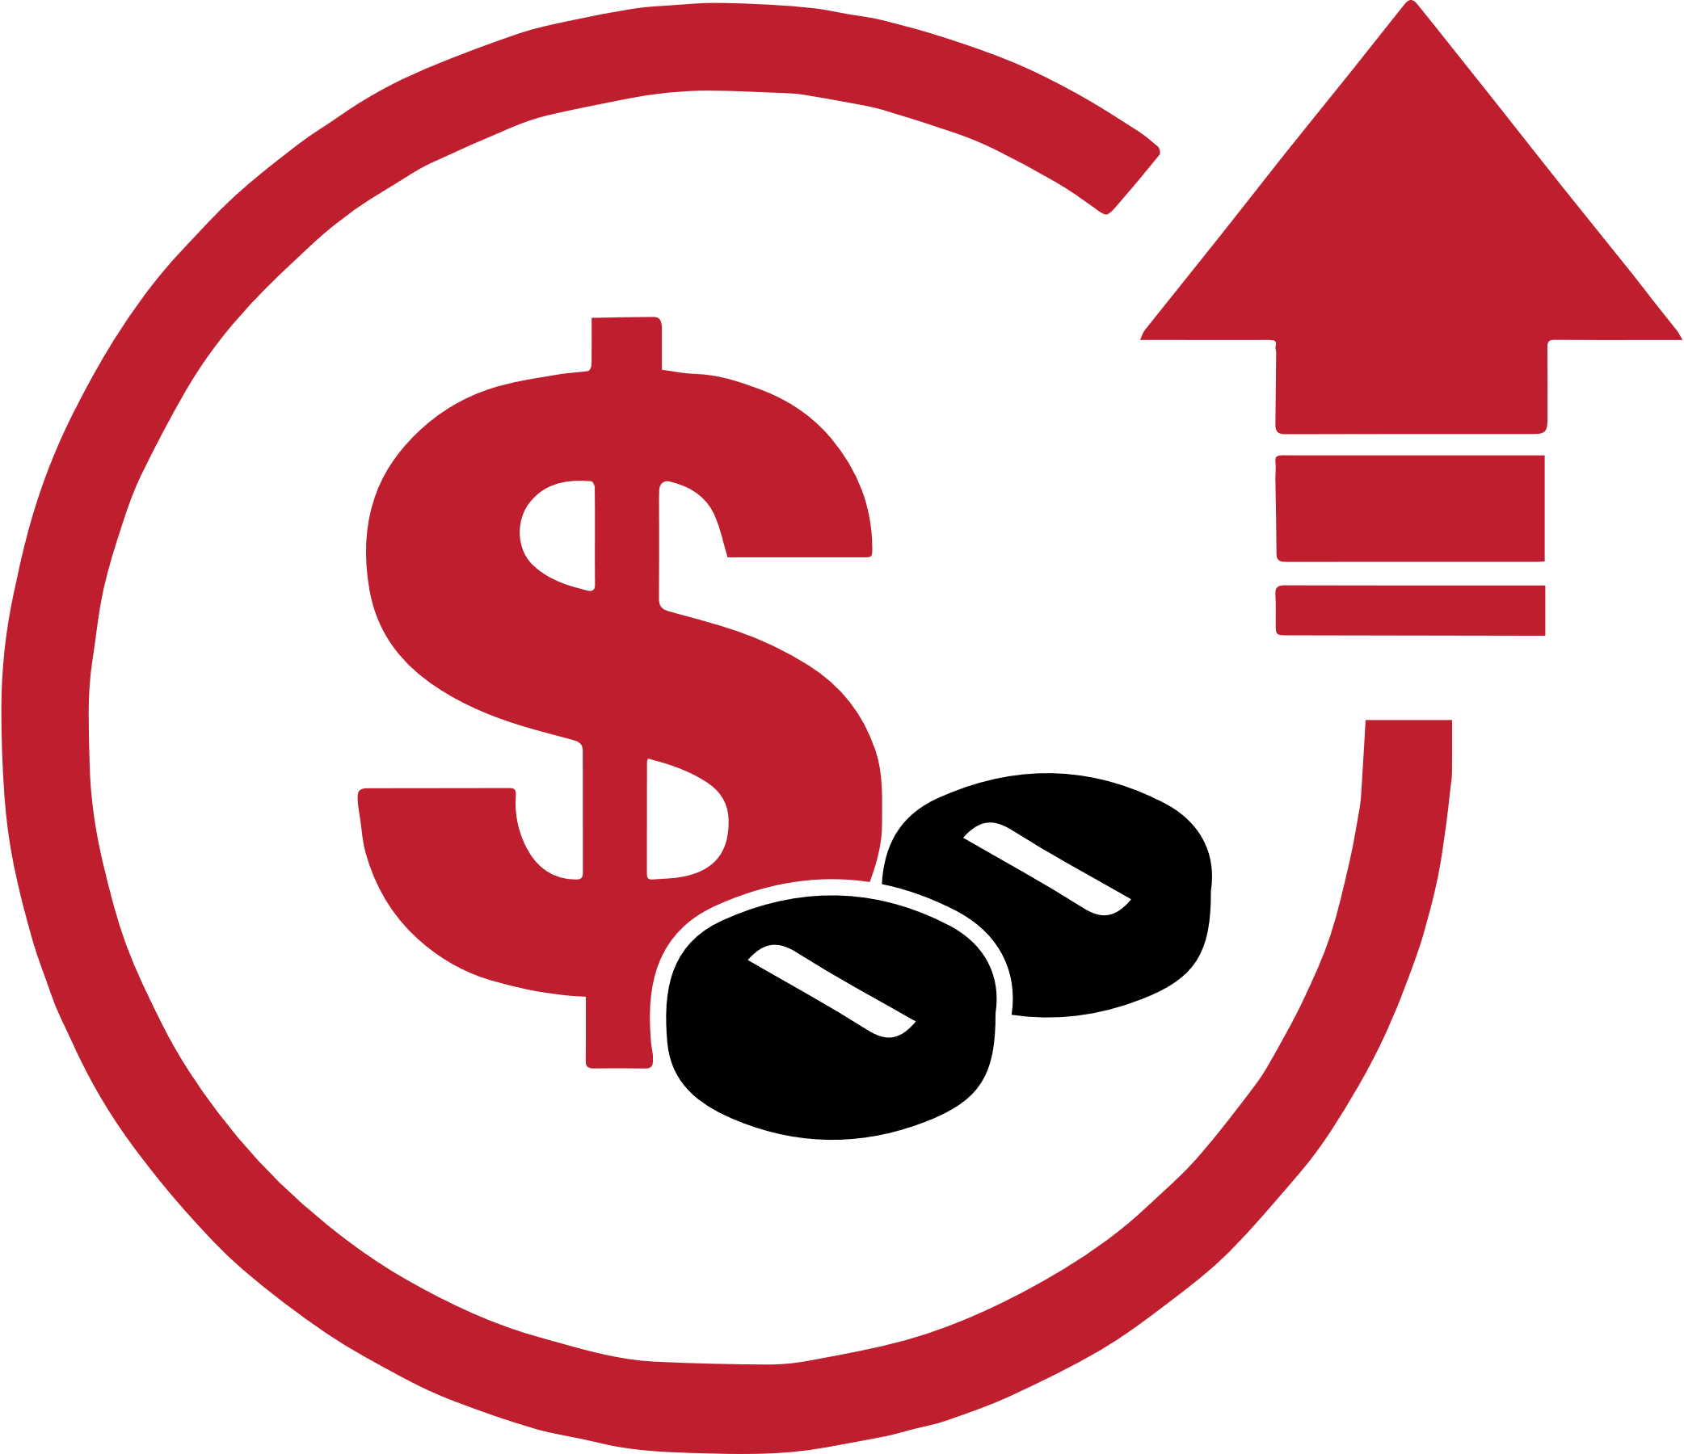
Every patient should be able to afford their medications.
The Problem:
The prices of drugs for which manufacturers offer coupons are going up 12-13% per year, as compared to 7-8% for
non-couponed drugs.
Leemore Dafny, Christopher Ody, and Matt Schmitt. “When Discounts Raise Costs: The Effect of Copay Coupons on Generic Utilization.” The National Bureau of Economic Research. (October 2016).

Slide 4

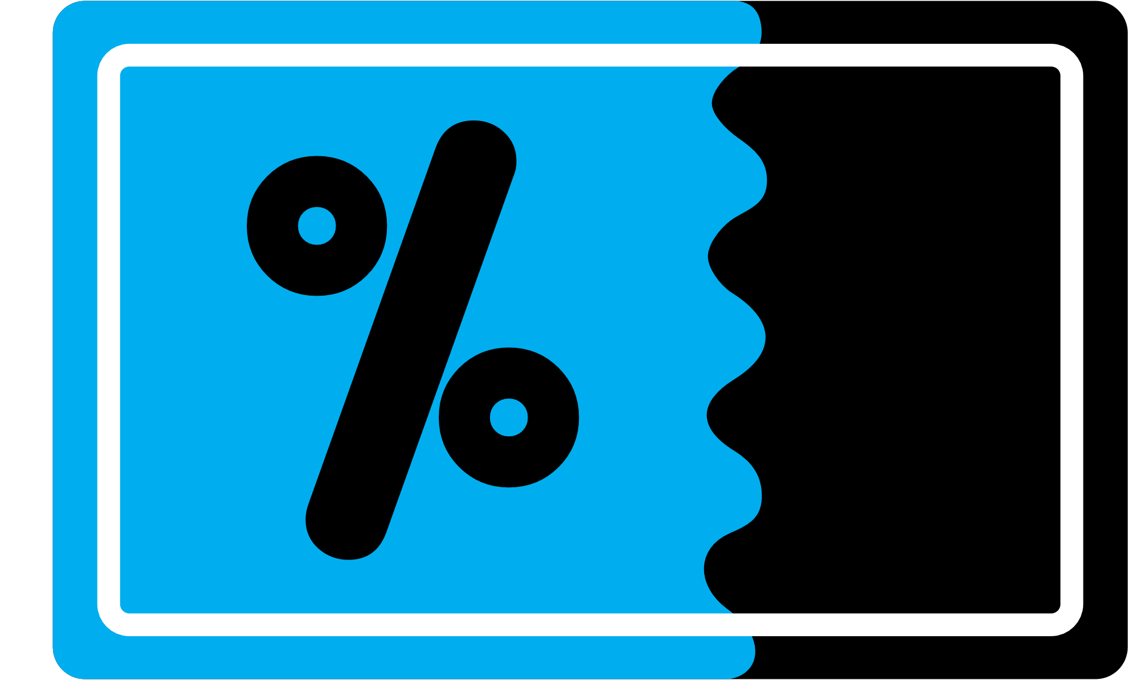
Why?
Brand-name drug manufacturers offer coupons to steer patients to use (or switch to) their more expensive drug instead of an equally effective, more affordable generic or brand alternative.
U.S. Department of Health and Human Services Office of Inspector General. “Manufacturer Safeguards May Not Prevent Copayment Coupon Use for Part D Drugs.” Report OEI-05-12-00540. (September 2014); and Commonwealth of Massachusetts. “Prescription Drug Coupon Study: Report to the Massachusetts Legislature.” (July 2020).

Slide 5

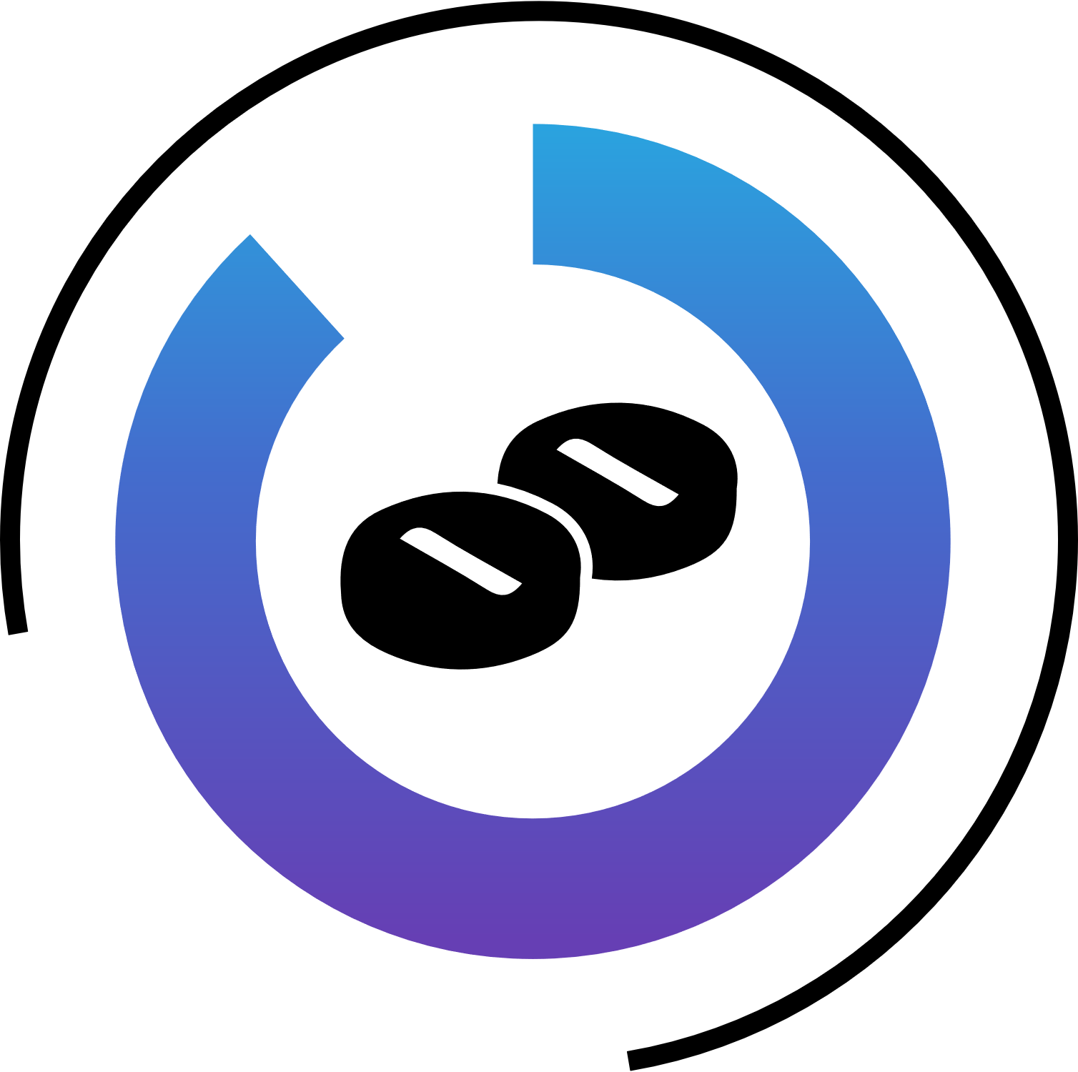
A USC Schaeffer analysis of the top drugs by spending found that 88% of brand drugs with manufacturer coupons were for medications for which lower-cost generics or brand alternatives were available.
88%
Karen Van Nuys, Geoffrey Joyce, Rocio Ribero, and Dana Goldman, USC Schaeffer Center for Health Policy & Economics. “A Perspective on Prescription Drug Copayment Coupons.” (February 2018). https://healthpolicy.usc.edu/wp-content/uploads/2018/02/2018.02_Prescription20Copay20Coupons20White20Paper_Final-2.pdf

Slide 6



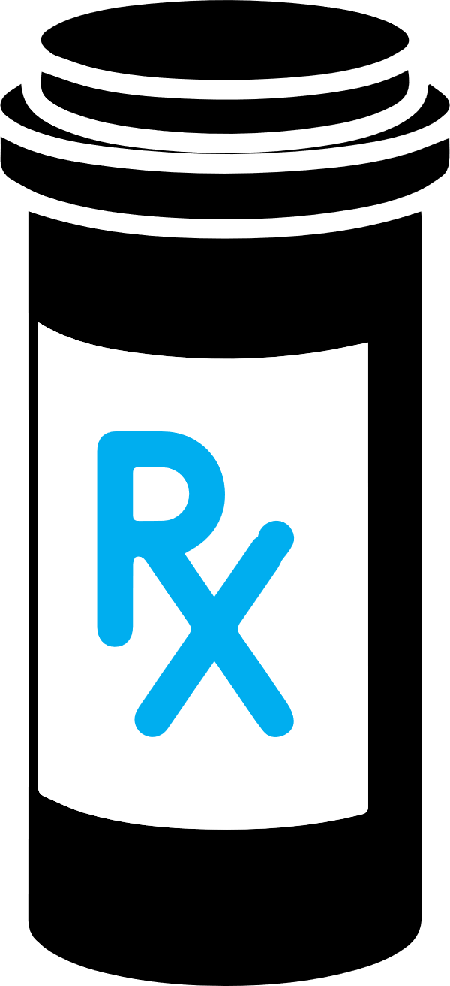

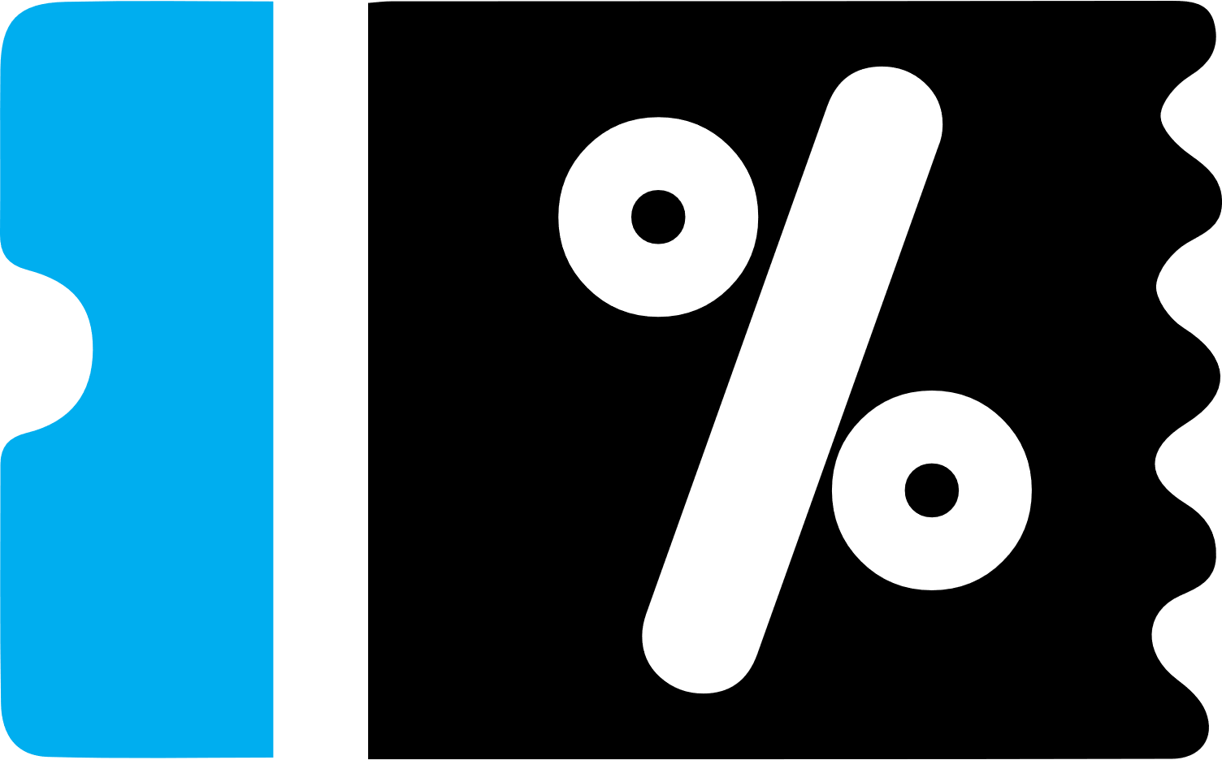
Consider a $2,250 brand-name drug
(for a 30-day supply):
Manufacturers set the prices of their prescription drugs. For example, a manufacturer may price a brand-name drug at $25 per pill, or $2,250 for a 30-day supply (at three pills per day). | Private negotiations between plan sponsors and manufacturers inform price concessions (“rebates”) and formulary placement (“tier”) strategies. | When there are more affordable generics or brand alternatives, the plan sponsor places that more expensive drug on a nonpreferred or specialty tier that imposes 25% coinsurance up to the plan’s annual out-of-pocket (OOP) limit. | To incent patients to use their drug instead of a more affordable option, the manufacturer makes available a coupon that limits the patient’s OOP costs to $100 per 30-day supply (instead of $562.50, or 25% of $2,250), with the manufacturer paying the difference ($462.50) to the pharmacy. | But the plan sponsor must still reimburse the pharmacy the remaining 75%, or $1,687.50 for this higher cost brand—raising costs for everyone.

Slide 7
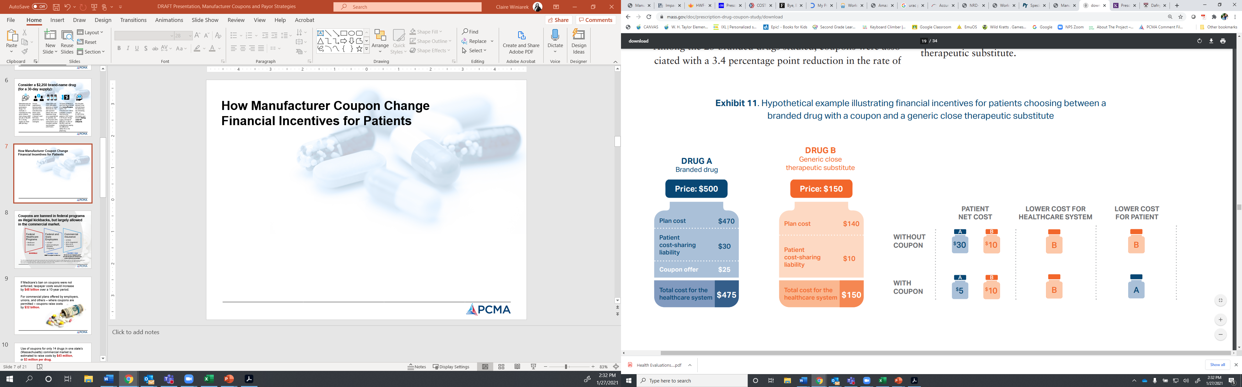
How Manufacturer Coupons Change Financial Incentives for Patients
Commonwealth of Massachusetts. “Prescription Drug Coupon Study: Report to the Massachusetts Legislature,” Exhibit 11. (July 2020).

Slide 8
Coupons are banned in federal programs as illegal kickbacks, but largely allowed
in the commercial market.
Federal Healthcare Programs
Medicare
Medicaid
Federal and State Employees
FEHBP
State Employee Benefits Programs
Commercial Insurance
ERISA
ACA Regulated
Non-ACA Regulated
BANNED
PERMITTED
SEBP is subject to state law
PERMITTED
California and Massachusetts* banned coupons for brand drugs where a generic is available.
The 2012 Massachusetts law authorizing commercial use of manufacturers coupons unless the drug has an “AB rated” generic equivalent also contained a sunset provision, under which the law would have been repealed on July 1, 2015. However, this date of repeal was postponed several times and ultimately extended to January 1, 2021. The state of New Jersey and New Hampshire also considered a coupon ban in 2018 and 2019, respectively.

Slide 9

What is the real impact of coupons on patients and overall drug spending?
If Medicare’s ban on coupons were not enforced, taxpayer costs would increase by $48 billion
over a 10-year period.
For commercial plans offered by employers, unions, and others, coupons raise costs
by $32 billion.
Use of coupons for 14 drugs in Massachusetts’ commercial market raised costs by an estimated $45 million*, or $3 million per drug.
* This calculation excludes the financial impact of coupons on the much larger number of drugs with generic alternatives not included among the 14 drugs, drugs with lower-cost branded alternatives, and drugs with no alternatives. See: Visante. “Drug Manufacturer Coupons Raise Costs in Medicare Part D, Hurting Vulnerable Beneficiaries.” (May 2020); Visante. “How Copay Coupons Could Raise Prescription Drug Costs By $32 Billion Over the Next Decade.” (November 2011); and Commonwealth of Massachusetts. “Prescription Drug Coupon Study: Report to the Massachusetts Legislature.” (July 2020).

Slide 10


While coupons may help some patients afford their prescription drugs by temporarily reducing OOP prescription drug costs, they do not reduce actual costs.
Coupons raise drug costs for everyone while increasing profits for manufacturers.

Slide 11
Going outside of the plan benefit to use coupons poses safety risks and deprives patients of critical clinical services that improve health outcomes.
These services are only possible when plans have full visibility into patients’ drug regimens.
Preventing adverse drug events and errors
Improving drug therapy and patient adherence to treatment plans
Reducing gaps in patient education and engagement
Assisting physicians in managing complex medication regimens

Slide 12

The Solution:
The simplest, most effective way to lower patients’ drug costs is for manufacturers to lower their prices.
PCMA supports programs that facilitate more affordable access to specialty and high-cost prescription drugs—not marketing schemes that undermine efforts to lower costs.

Slide 13
Payor Approaches to Reducing the Harmful Effects of Manufacturer Coupons

Slide 14
What are Accumulator Adjustment Programs?
Highlights
Mitigates the harmful impact of manufacturer coupons on overall plan costs and member premiums
Most common among employer-sponsored high-deductible health plans
Survey of large employers suggest half adopted or considered an accumulator in 2019 to help lower premiums and plan costs^
Requires payor visibility into use of coupons
Sometimes called “coupon adjustment” or “out-of-pocket protection,” accumulator adjustment programs ensure the integrity of the benefit design and member cost-sharing requirements by excluding manufacturer coupons and other forms of patient assistance from the deductible and out-of-pocket maximum amounts.*
* Federal regulations currently permit adjustment programs in the commercial market, including for fully insured, ERISA, ACA, and non-ACA regulated plans; EGWP, Medicaid, and Medicare plans are ineligible. ^ Other surveys suggest the figure may be as high as 75% of employers of all sizes and 54% of large employers. Source: National Business Group on Health, 2019.

Slide 15
What are Maximizer Programs?
Highlights
Brings value of coupons into the broader plan benefit—lowering costs for all plan members
Most often apply to high-cost specialty drugs
Patients often have $0 responsibility—even after copay assistance has been exhausted
Patient and plan costs are smoothed over the course of the year, helping to make these high costs more manageable
Sometimes called “variable copay” programs and often combined with accumulator adjustment, maximizer programs set the member cost-sharing amount to the maximum value of available manufacturer coupons for that drug. This drug-specific cost-sharing requirement may revert to the standard plan design if coupons become unavailable, are exhausted, or the member does not use them.
As with accumulator programs, maximizer programs require exclusive use of a PBM-affiliated pharmacy. To maximize member benefit, members may receive support to enroll in manufacturer assistance programs. Some variations of this program do not have the alternative “base plan design” in cases where coupons are not used. EGWP, Medicaid, Medicare, ACA, and HRA plans are ineligible.

Slide 16
What are Specialty Drug Select Savings Programs?
Highlights
Often include patien-centered support, education, and clinical case management
May reduce patient OOP costs for up to 300+ high-cost, specialty drugs
Point-of-sale claim triggers outreach to facilitate the patient’s enrollment in the
needs-based PAP
Unlike coupons, PAPs are not banned in federal healthcare programs
Under these programs, patient advocates help identify and facilitate enrollment in needs-based manufacturer, charitable, and other patient assistance programs (PAPs) for patients who take select specialty drugs. If the patient is ineligible for such programs, or the funds are depleted, patients retain access to care under normal processes and the standard benefit design.
PBMs do not determine if or how payors implement maximizer programs and similar strategies; these remain at employers’ and other plan sponsors’ sole discretion in terms of both design and use.

Slide 17
Accumulator-Maximizer Programs Reduce OOP Costs for Patients
Spending without Coupon Management
Manufacturer: $4,850
Patient: $150^
Plan Sponsor: $19,000
Extra Manufacturer Revenue: $1,300 Per Patient
Spending with Combined Accumulator-Maximizer Program
Manufacturer: $6,050
Patient: $0 to $300*
Plan Sponsor: $17,700
^ Assumes availability of manufacturer coupon for the full six-month period. * These programs often include a zero-dollar option for enrolled members. PBMs do not determine if or how payors implement accumulator adjustment programs and similar strategies; these remain at employers’ and other plan sponsors’ sole discretion in terms of both design and use.

